Slide 1
Supplementary Slides

Slide 2
Media Links
https://www.mylondon.news/weather/london-weather-live-capital-battered-25333409
https://www.standard.co.uk/news/london/london-weather-storm-fire-brigade-b1034815.html
https://www.lbc.co.uk/news/travel-disruption-flash-flooding-monday/
https://x.com/ScottDuncanWX/status/1584267071340150784

Slide 3
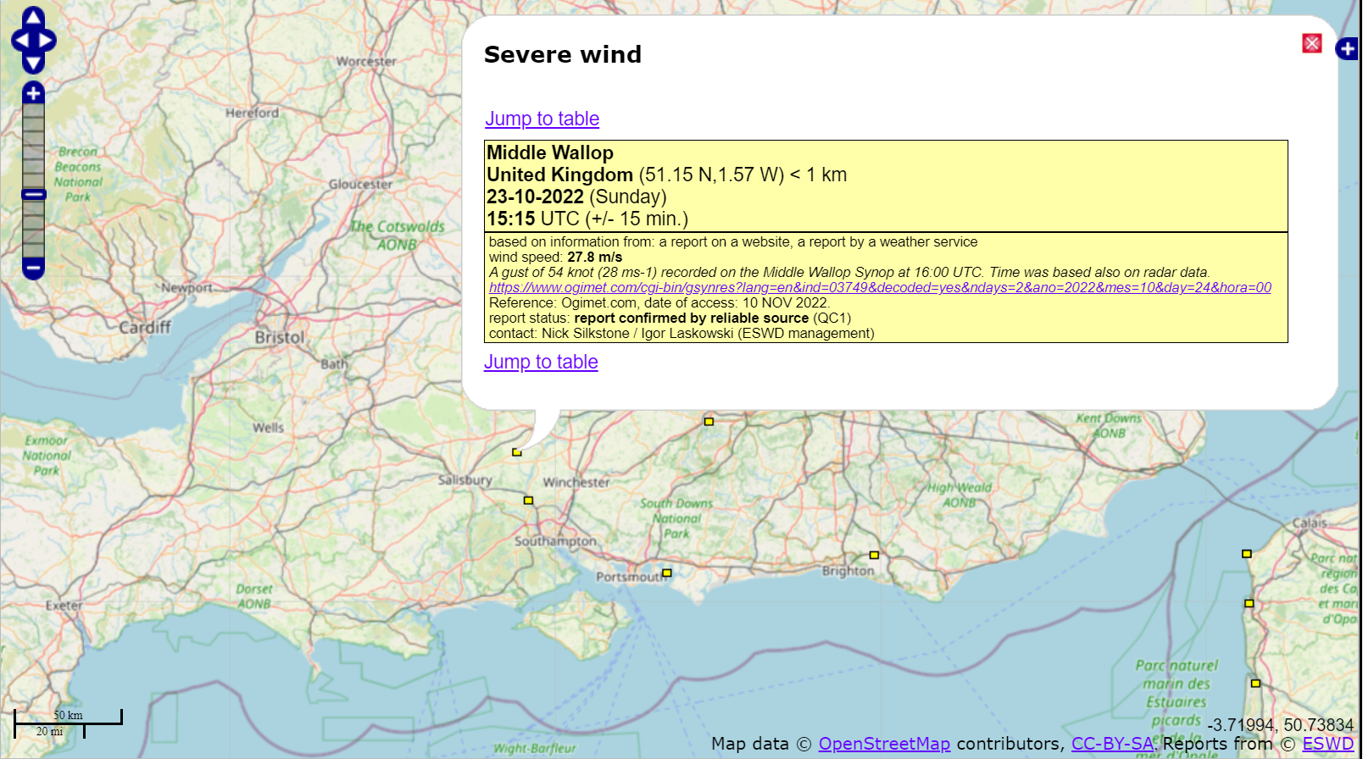
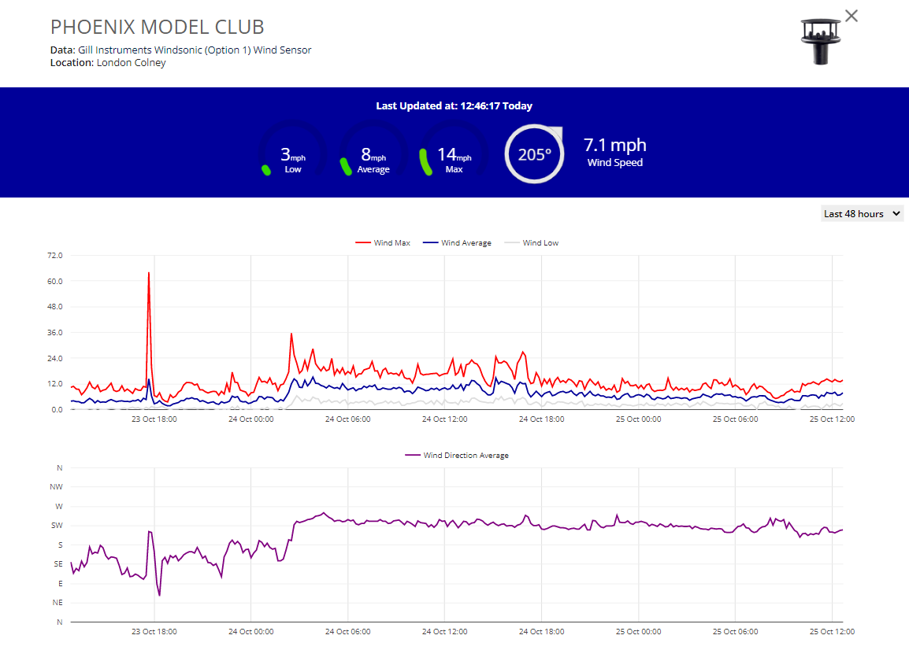
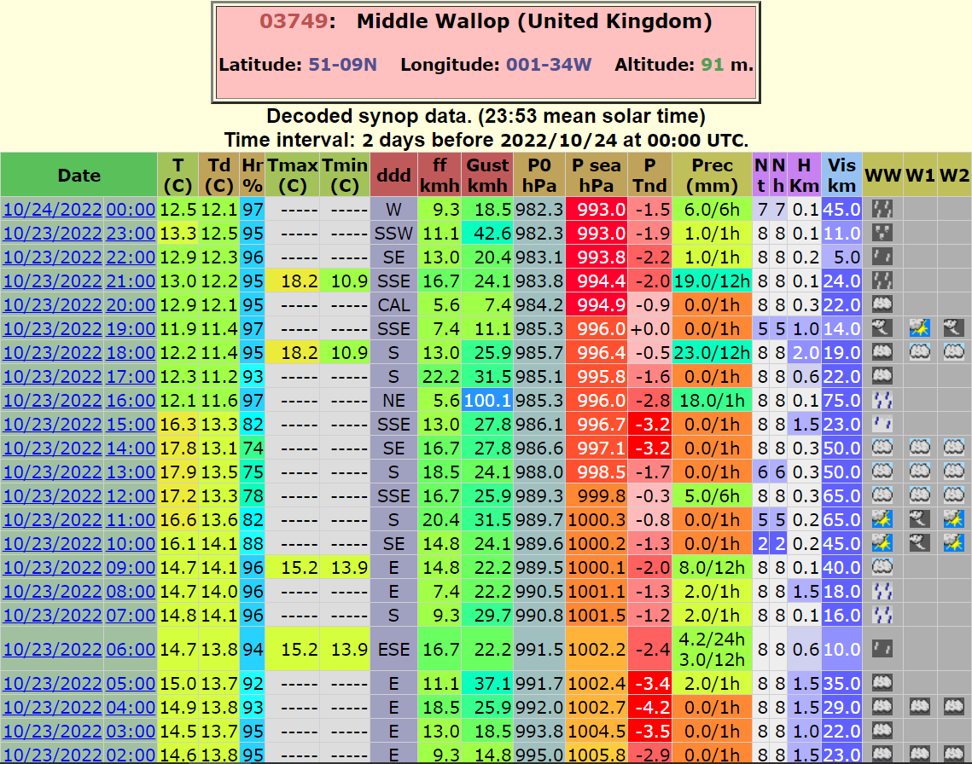
Downburst Wind Observations

Slide 4
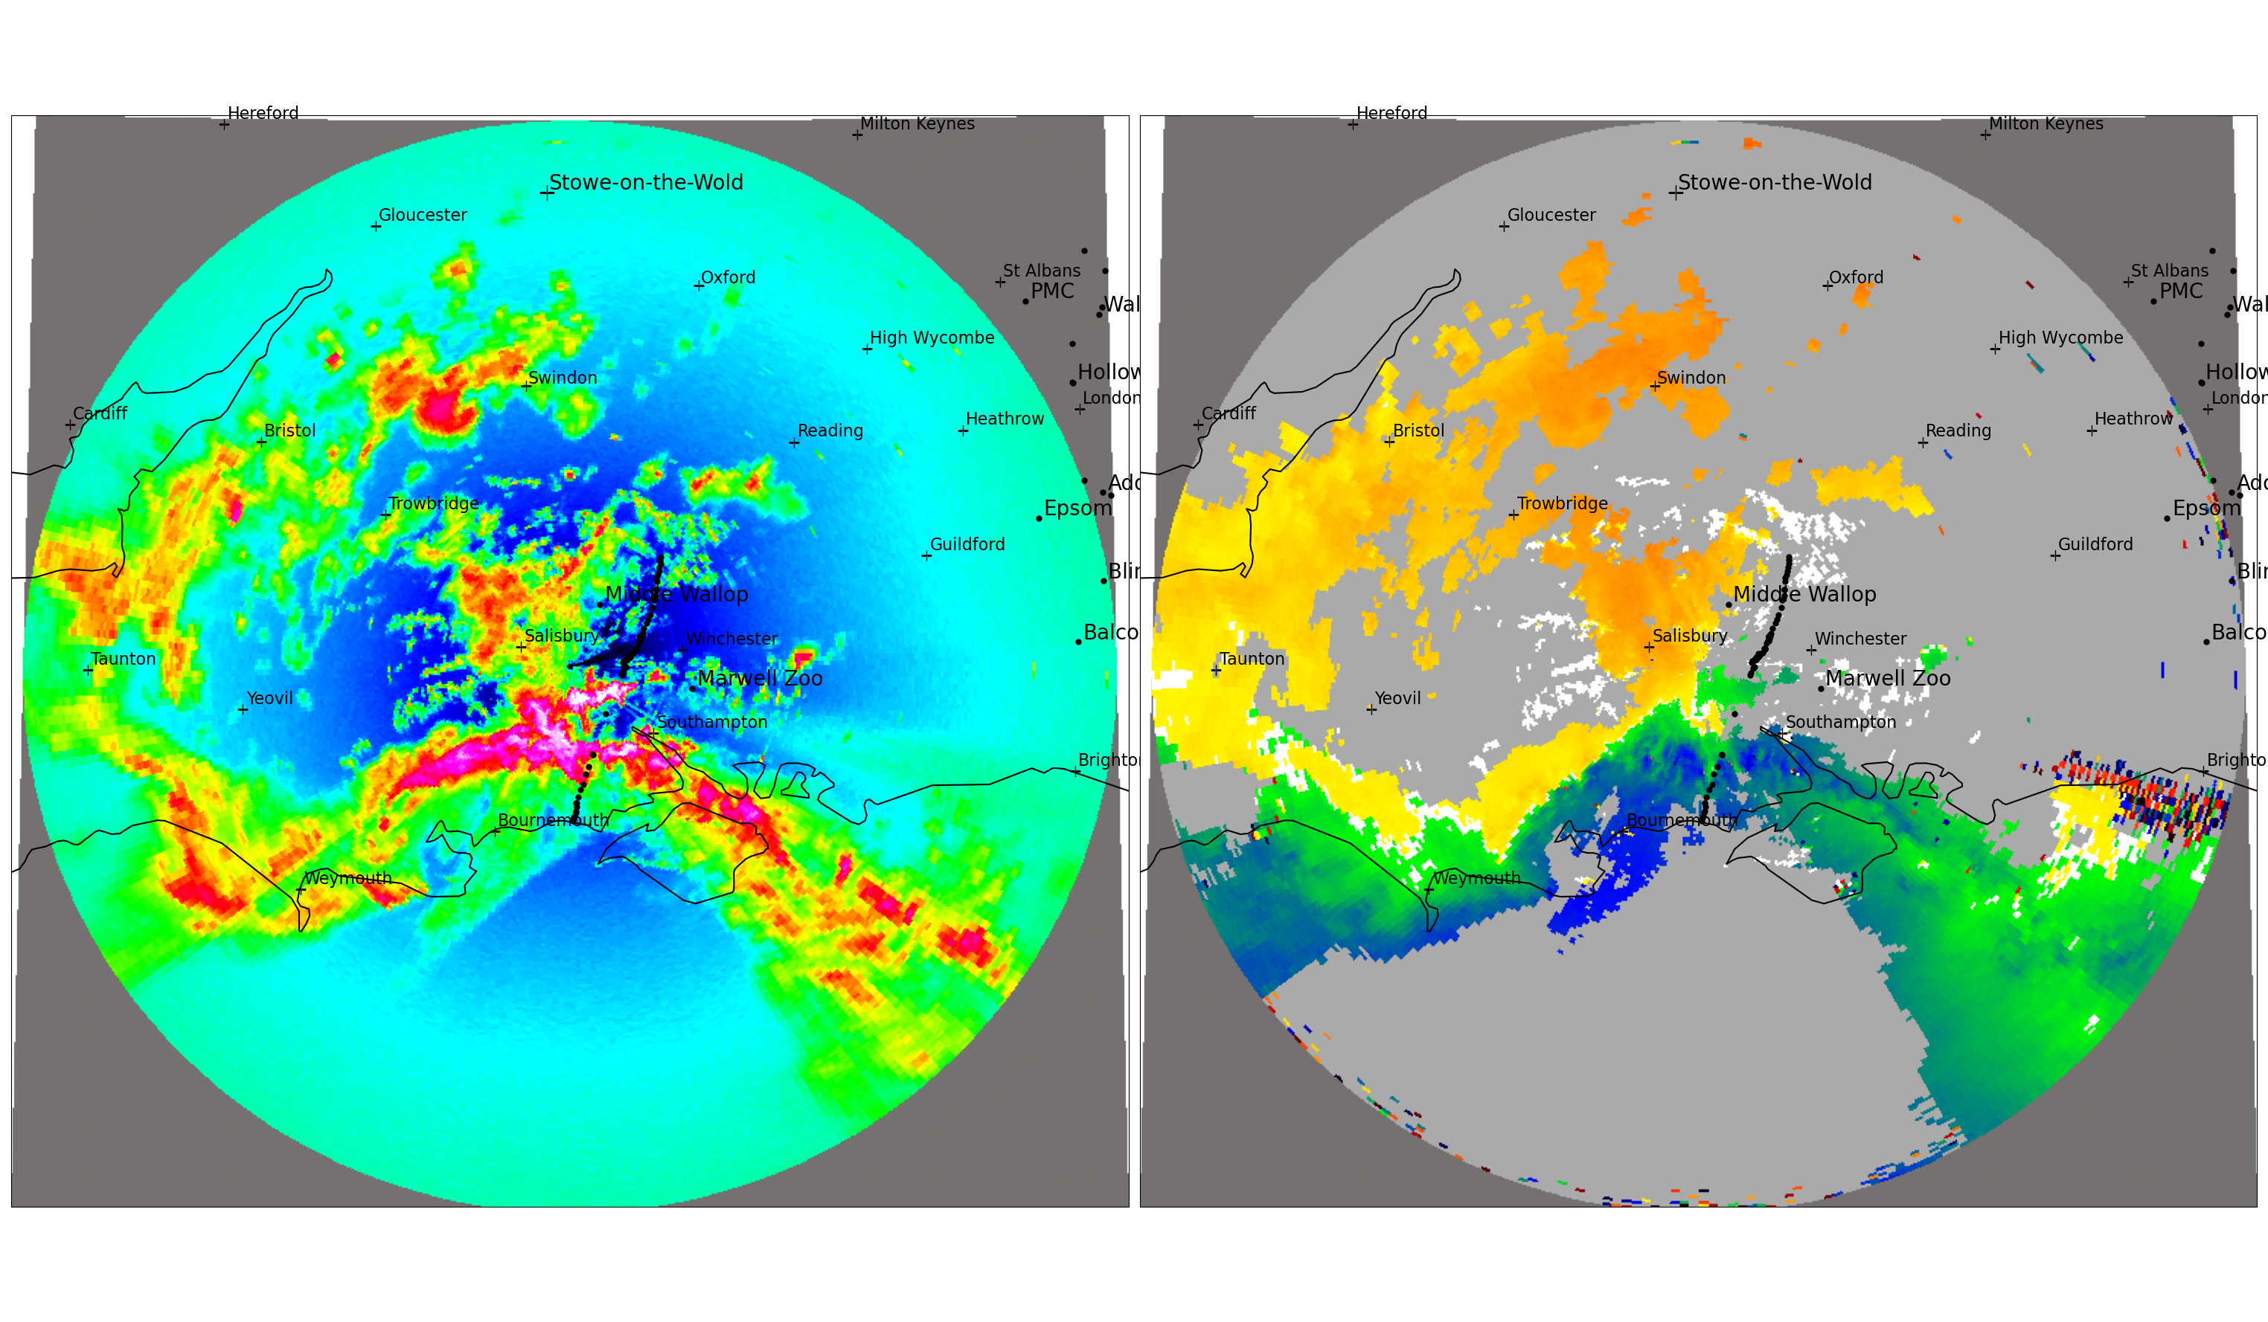
1451 UTC

Slide 5
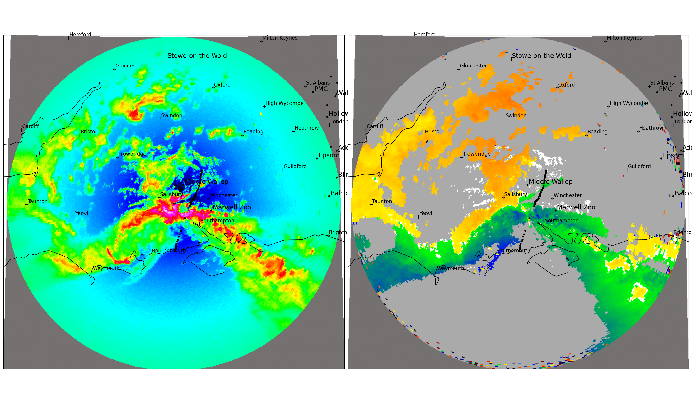
1501 UTC

Slide 6
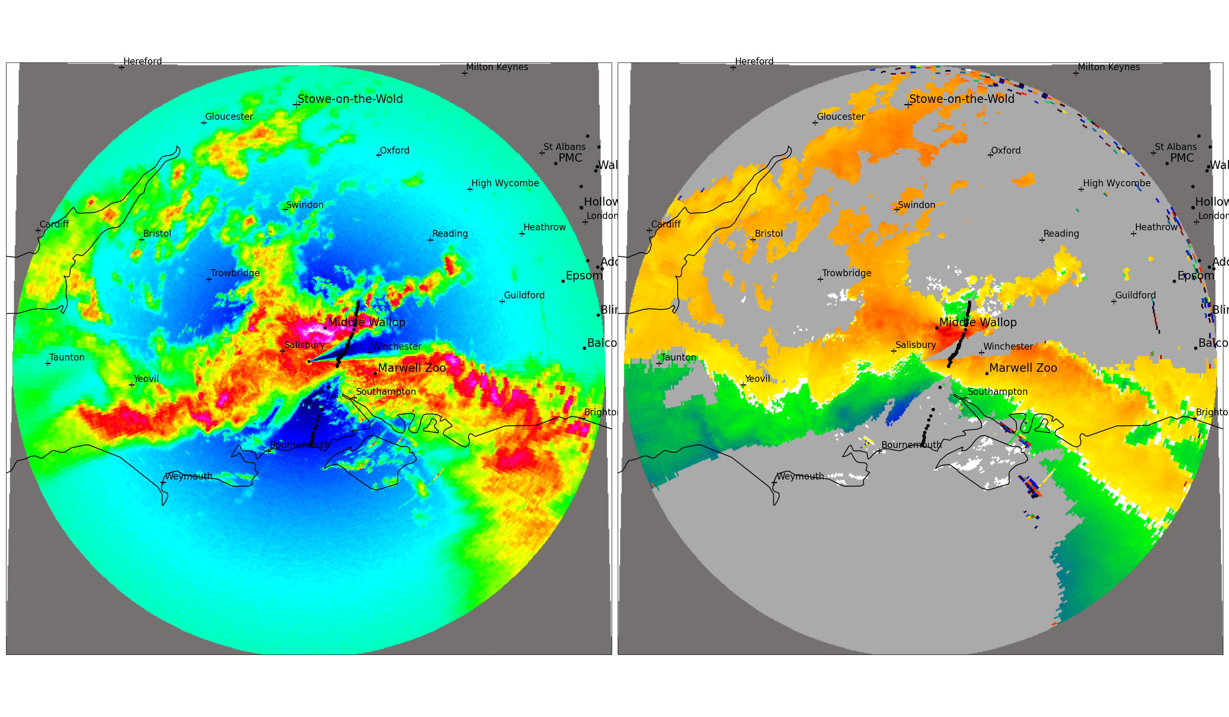
1521 UTC

Slide 7
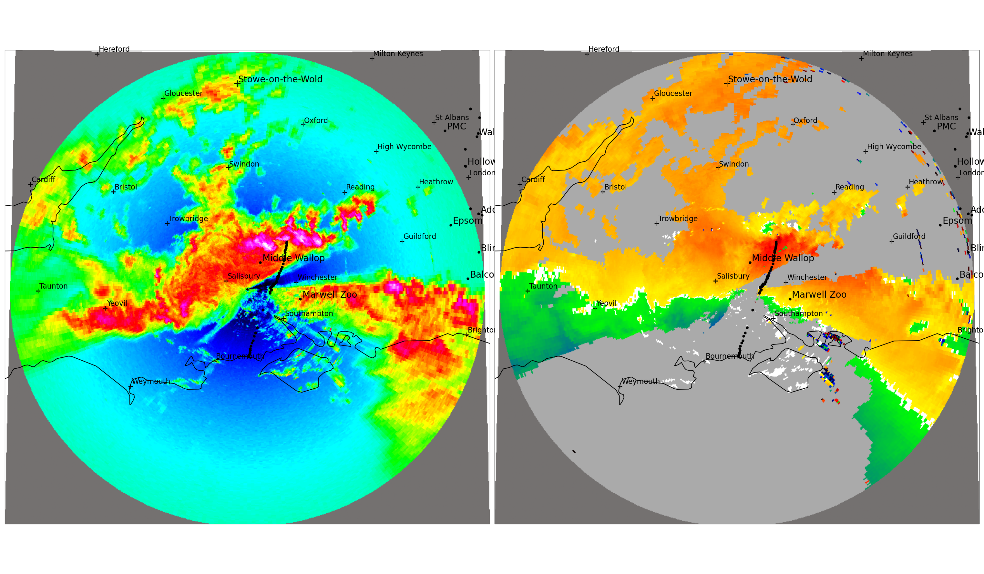
1531 UTC

Slide 8
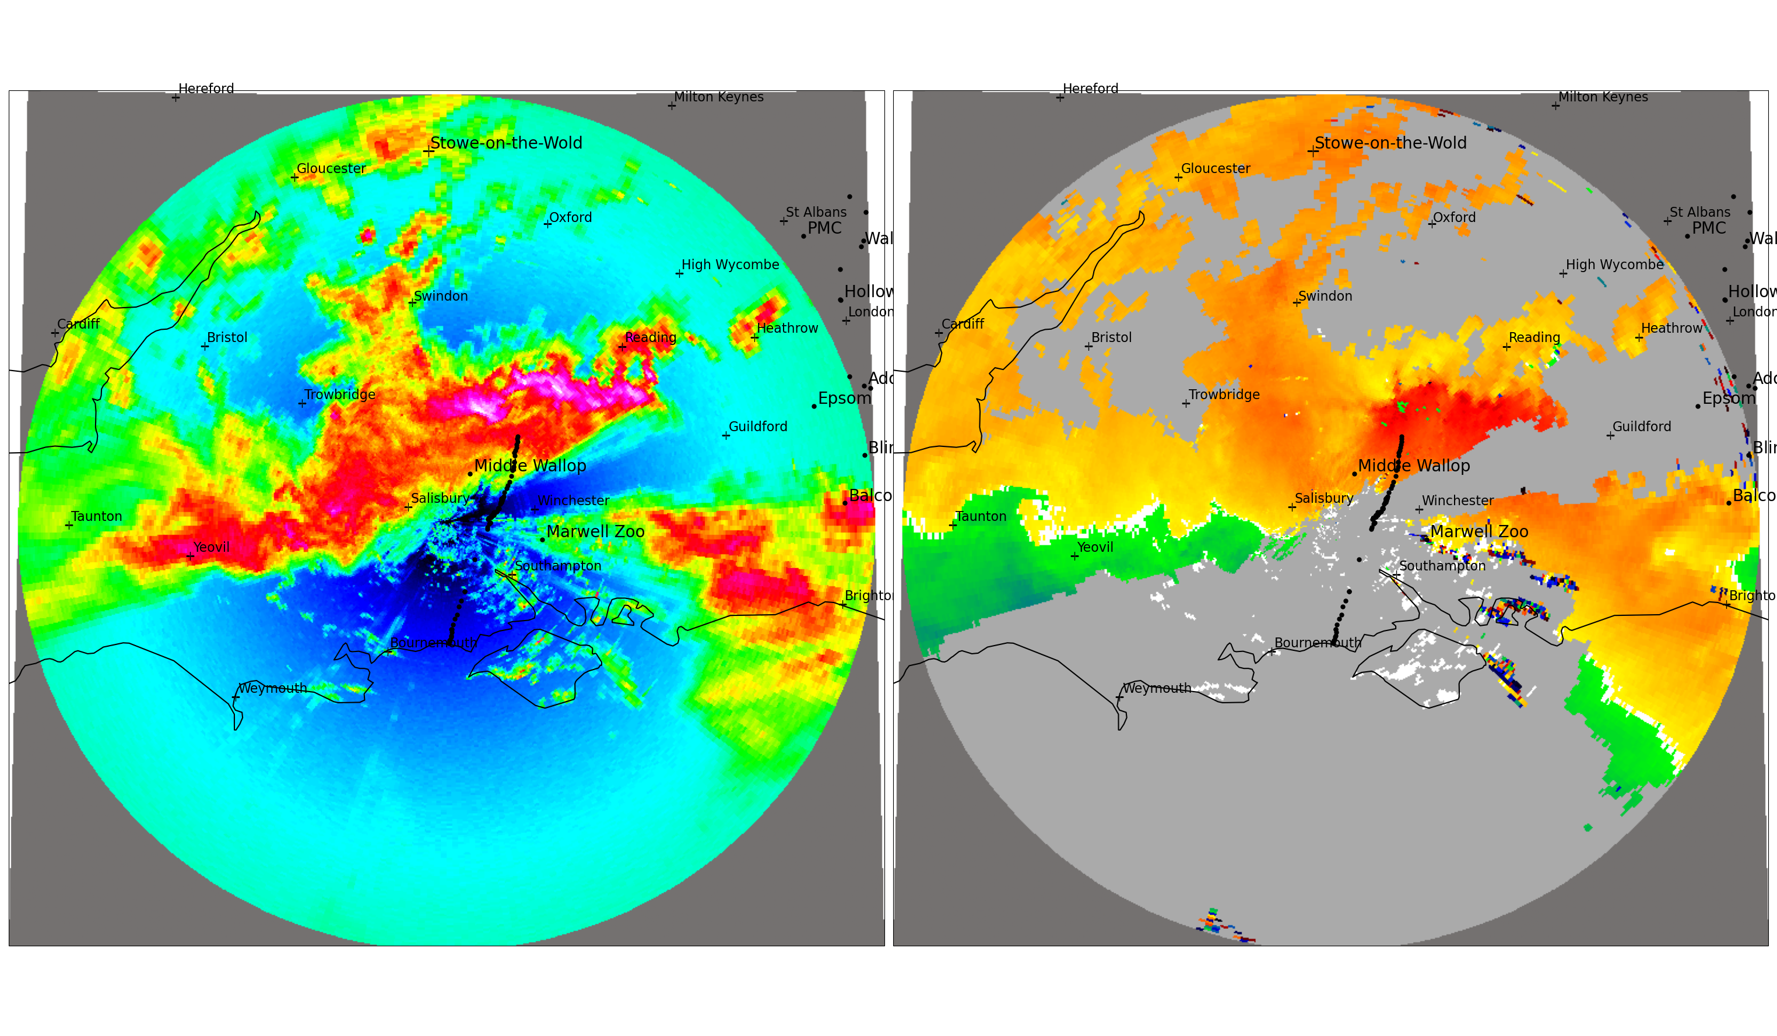
1541 UTC

Slide 9
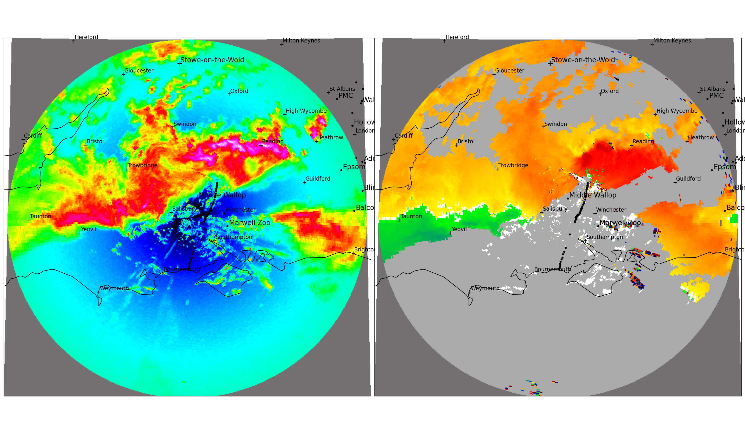
1551 UTC

Slide 10
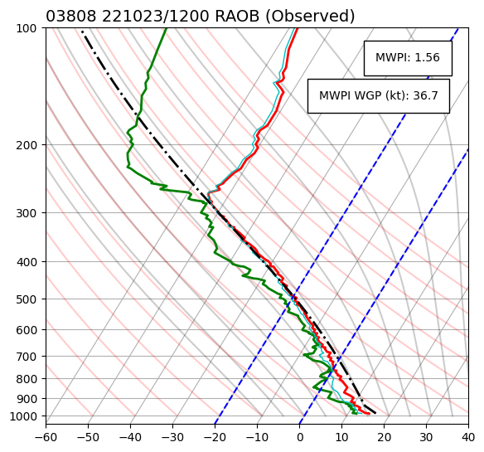
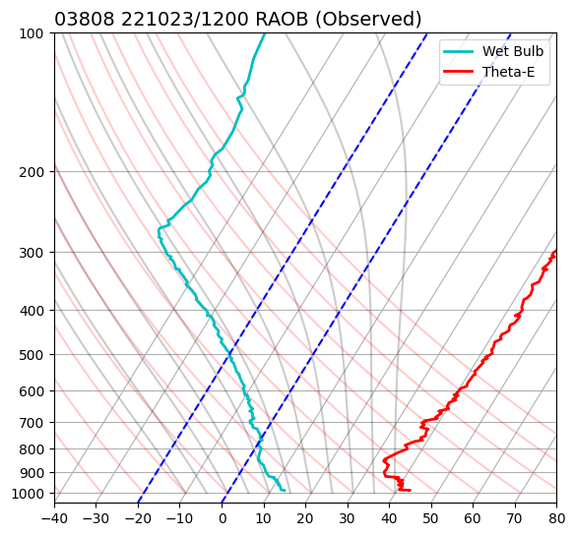
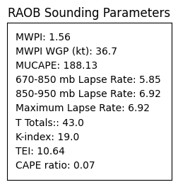
RAOB Sounding: Camborne, Cornwall, UK
a)
b)
WGP + 10 = 46.7 kt
Optimal for strong convective winds
Conditional/potential instability
Notes:
Add one-third of the forward storm motion to the MWPI WGP (based on the old Air Force Technical Memorandum 200 [Miller 1972]).
Storm motion = 30 knots, 1/3*storm motion = 10 knots

Slide 11
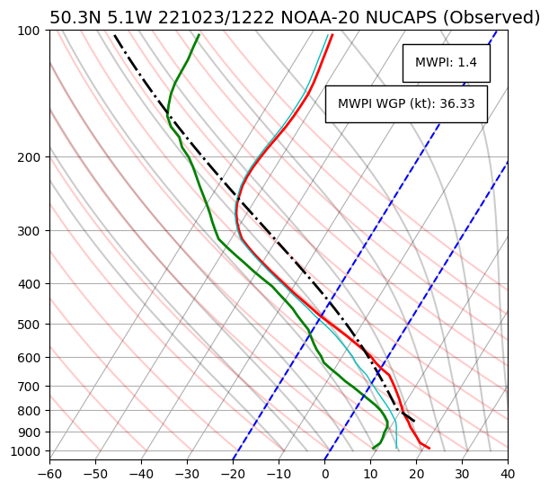
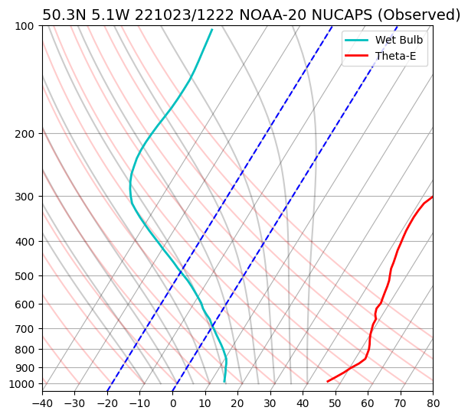
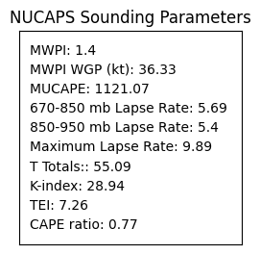
NOAA-20 NUCAPS: Truro, Cornwall, UK
a)
b)
WGP + 10 = 46.3 kt
Conditional/potential
instability
Unsaturated layer
WBZ
Optimal for strong convective winds

Slide 12
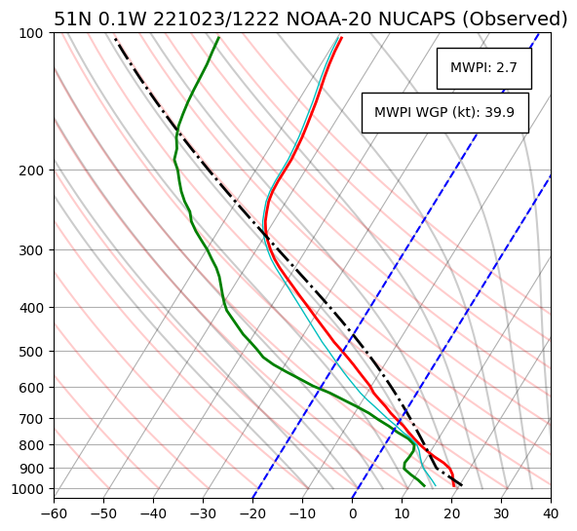
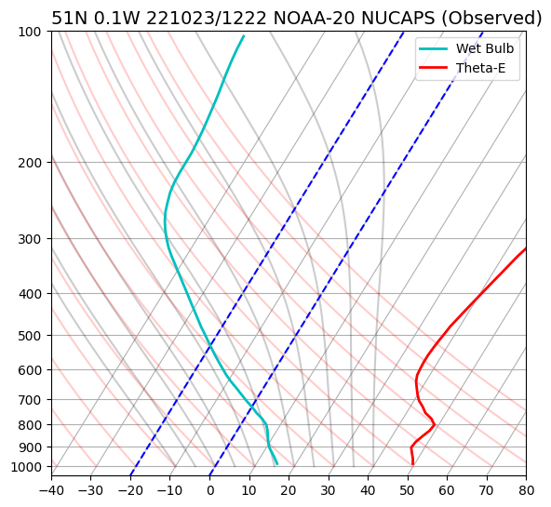
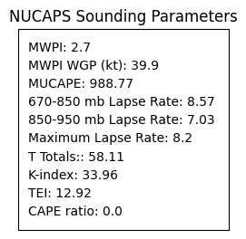
NOAA-20 NUCAPS: Haywards Heath, WS, UK
a)
b)
WGP + 10 = 49.9 kt
CI/PI
WBZ
Optimal for strong convective winds

Slide 13
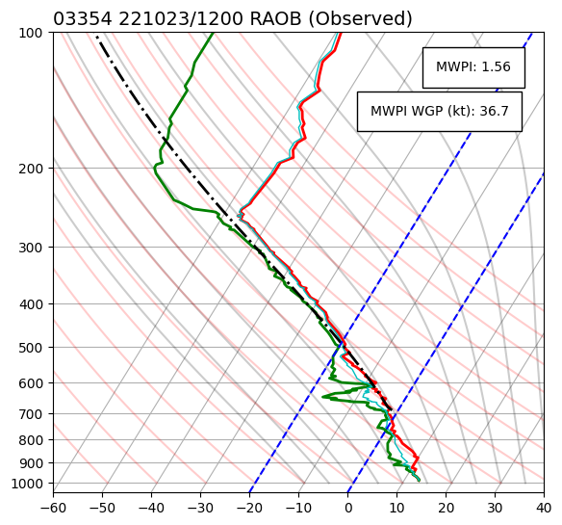
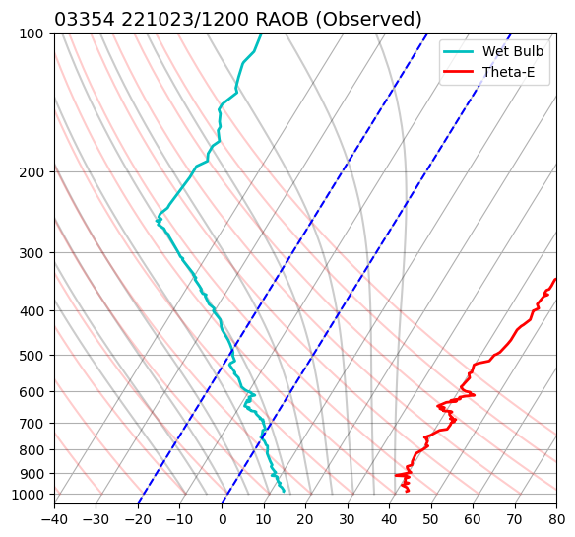
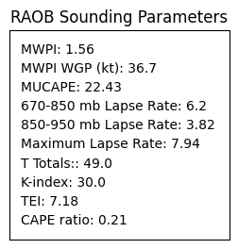
RAOB Sounding: Nottingham, UK
a)
b)
WGP + 15.3 = 52 kt
Conditional/potential instability
Notes:
Storm motion = 46 knots, 1/3*storm motion = 15.3 knots

Slide 14
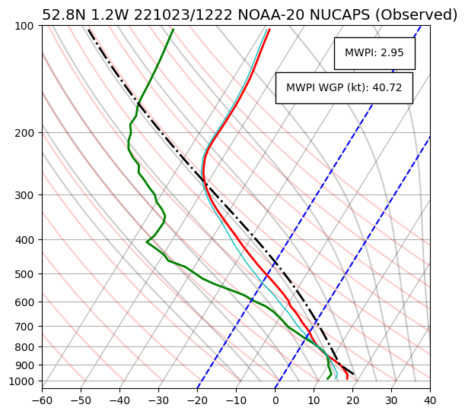
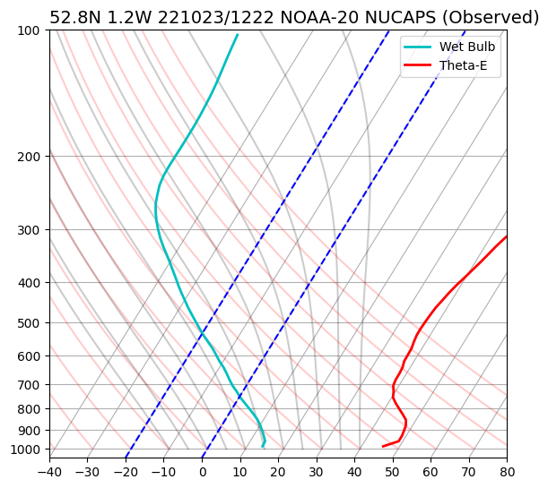
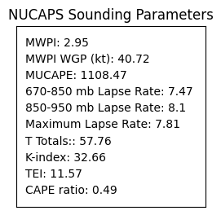
NOAA-20 NUCAPS: Loughborough, Leicestershire, UK
a)
b)
WGP + 15.3 = 56 kt
Potential instability
WBZ
Conditional instability

